Slide 1
CSS:
Cascading Style Sheets

Slide 2
What is CSS?
It is a "style sheet language" to describe the layout and presentation of a markup language, most commonly HTML.
It is text written to alter how other text (markup) is displayed.
But first, some history!

Slide 3
Timeline
1969-1990 ARPANET
"This has made a lot of people very angry and been widely regarded as a bad move." - Douglas Adams
1989 Tim Berners-Lee writes RFC for the World Wide Web
1990 Tim Berners-Lee writes the first version of HTML
Nov 24, 1995 HTML 2 RFC 1866
Nov 24, 1995 HTML with form-based file uploads RFC 1867
Jan 14, 1997 HTML 3 W3C Recommendation
Dec 18, 1997 HTML 4 W3C Recommendation
Oct 28, 2014 HTML 5 W3C Recommendation

Slide 4
Sidebar: Request for Comments (RFCs)
A way to standardize a syntax or protocol with respect to the "internet"
Anyone can make a proposal
Anyone can comment
Published to the IETF (Internet Engineering Task Force) of the ISOC (Internet Society, a non-profit) aka a different group of people with vested interests that this whole "internet thing" stays working
RFCs either get revised, go away, or become the standardRFCs can be in one of the following states: Informational, Experimental, Best Current Practice, Standards Track, or Historic

Slide 5
Sidebar: Some popular RFCs
Why is my email address formatted this way? https://datatracker.ietf.org/doc/html/rfc5322#section-3.4
What are valid characters I can have in a URL and how can I add data via query parameters? https://datatracker.ietf.org/doc/html/rfc3986/#section-3.4
What are we gonna do about running out of IPv4 addresses? https://datatracker.ietf.org/doc/html/rfc8200
What is this IRC thing the "engineers" are so fond of? https://datatracker.ietf.org/doc/html/rfc2810

Slide 6
Sidebar: RFCs versus W3C "Recommendations"
What is the W3C?
World Wide Web Consortium, founded 1994, international community that any organization can join
What is a W3C Recommendation?
A way to standardize a syntax or protocol with respect to the "world wide web"
What is a W3C Standard?
A recommendation that has been edited, agreed upon, and finalized
Very similar processes with different names/groups involved
W3C cares about the "web" and less so the "internet" so things like TCP/IP are RFCs and things like HTML/CSS/Web Sockets are W3C Recommendations

Slide 7
Sidebar fin.
There are many "standards" at various stages of adoption. (obligatory xkcd 927)
Everything that is good and bad about the internet is because it is a collaborative and evolving project.
Anyone can make a RFC or make a comment
RFCs and W3Cs are generally very dry and for people that are implementing the spec not using the spec so they contain information about how things work not how to use them.
The rest of this talk will be about how to use them. Just know that the theoretical "truth" is contained somewhere between the specs and the source code of the implementations.

Slide 8
Timeline Continued
Dec 4, 1995 Netscape released and with it the first version of JavaScript
Dec 17, 1996 CSS1 (aha! finally! Håkon Wium Lie makes the initial proposal)
https://www.w3.org/TR/CSS1/
"The first commercial browser to support CSS was Microsoft's Internet Explorer 3, which was released in August 1996." https://www.w3.org/Style/CSS20/history.html (That was prior to the finalized spec which means that IE had to change later.)
May 12, 1998 CSS2
https://www.w3.org/TR/2008/REC-CSS2-20080411/
Jun 7, 2011 CSS2.1
Primarily for backwards and forwards compatibility and to lay groundwork for CSS3
https://www.w3.org/TR/CSS2/

Slide 9
CSS3+
Began draft work after CSS2 was finalized in 1999
After CSS2.1 CSS3 became "modularized" now each specific thing in CSS is a module and they can be updated independently of each other. CSS 2.1 is the base and modules override portions as needed
There are now "Snapshots" of the list of all of the standards that make up the current CSS standard. Each module has its own level/version
https://www.w3.org/TR/css-2020/
Slight lag between release snapshot and implementations

Slide 10
Okay wait so what is CSS?
Text you write to describe how other text you write looks
Where in both cases it may be surrounded by text you didn't write
Examples of things that can produce additional CSS that your CSS interacts with explicitly or implicitly:
Other developers
Frameworks
CSS
JavaScript
User Generated Content

Slide 11
CSS Syntax Declaration Blocks
Selector
declaration/rule
keyword
value
property
.myClass p #myId {
color: lightgray;
font-size: 24px;
}

Slide 12
CSS Syntax
A declaration can have the "!important" modifier as follows
property: value !important;
All declarations in the block apply to all the elements that match the selector
If an element matches multiple selectors all the rules for all the selectors are applied and conflicts are resolved via the cascade

Slide 13
Properties
Not all properties are applicable/actually do things for all elements
An incomplete list of properties that can be set:
background-attachment
background-color
background-image
background-position
background-repeat
border
border-bottom
border-bottom-color
border-bottom-style
border-bottom-width
border-color
border-left
border-left-color
border-left-style
border-left-width
border-right
border-right-color
border-right-style
border-right-width
border-style
border-top
border-top-color
border-top-style
border-top-width
border-width
clear
clip
color
cursor
display
filter
float
font
font-family
font-size
font-variant
font-weight
height
left
letter-spacing
line-height
list-style
list-style-image
list-style-position
list-style-type
margin
margin-bottom
margin-left
margin-right
margin-top
overflow
padding
padding-bottom
padding-left
padding-right
padding-top
page-break-after
page-break-before
position
stroke-dasharray
stroke-dashoffset
text-align
text-decoration
text-indent
text-transform
top
vertical-align
visibility
width
z-index

Slide 14
/* This slide intentionally left blank. */
.empty-slide {
display: none;
}

Slide 15
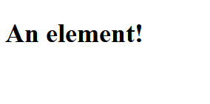
An example
Input
Output
<!DOCTYPE html>
<html>
<head>
<title>An example</title>
</head>
<body>
<h1>An element!</h1>
</body>
</html>

Slide 16
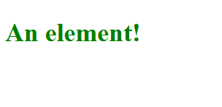
An example
Input
Output
<!DOCTYPE html>
<html>
<head>
<title>An example</title>
<style>
h1 {
color: green;
}
</style>
</head>
<body>
<h1>An element!</h1>
</body>
</html>

Slide 17
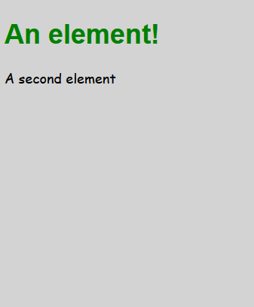
An example
Input
Output
<!DOCTYPE html>
<html>
<head>
<style>
h1 {
color: green;
font-family: Arial, sans-serif;
}
body {
background: lightgrey;
font-family: "Comic Sans MS", cursive;
}
</style>
</head>
<body>
<h1>An element!</h1>
<p>A second element</p>
</body>
</html>

Slide 18
/* This slide intentionally left blank. */
.empty-slide {
display: none;
}

Slide 19
CSS Selectors
HTML elements have:
tags/a type: h1, p, div
relationships: they are children or siblings or other elements
an Id (optional) <div id="customIdThatWeGetToMakeUp"></div>
classes (optional) <p class="someOtherNameWeMake aSecondClassEven"></p>
The order of classes on the element doesn't matter both of the above classes are applied based on their ordering in the style sheets
attributes
many other things
CSS Selectors can select things by:
tags/type: h1, p, div
relationships: div > p
ID: #customIdThatWeGetToMakeUp
class: .aSecondClassEven
attributes
pseudo-attributes

Slide 20
CSS selectors examples
h1
Read: all of the HTML elements that have a type of "h1"
<h1>Matches</h1>
<h2>Doesn't Match</h2>
<h2 class="h1">Doesn't Match</h2>
<div>
<h1>Matches</h1>
</div>
h1 {
color: green;
}

Slide 21
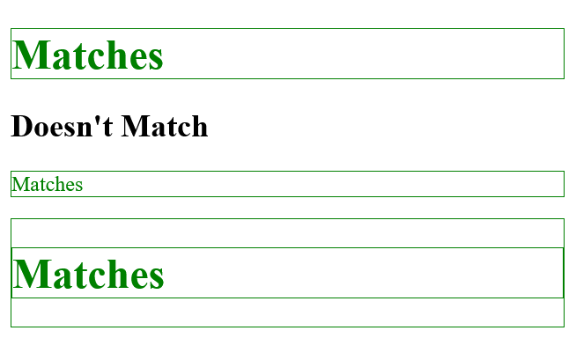
CSS selectors examples
h1, p, div
Read: all of the HTML elements that have a type of "h1", "p", or "div"
<h1>Matches</h1>
<h2>Doesn't Match</h2>
<p>Matches</p>
<div>
<h1>Matches</h1>
</div>
h1, p, div {
color: green;
border: 1px solid green;
}

Slide 22
CSS selectors examples
#someId
Read: the singular HTML element that has the id="someId"; it is invalid HTML to have two elements with the same id
<h1>Doesn't Match</h1>
<h2 id="someId">Matches</h2>
<p>Doesn't Match</p>
<h3>Doesn't Match</h3>
#someId {
color: green;
}

Slide 23
CSS selectors examples
.someClass
Read: all of the HTML elements that have the class="someClass"
<h1 class="someclass">Doesn't Match</h1>
<h2 id="someId">Doesn't match</h2>
<p class="someClass">Matches</p>
<h3 class="someClass">Matches</h3>
.someClass {
color: green;
}

Slide 24
CSS selectors examples
div p
Read: all of the paragraph tags that are inside of a div element
<p>Doesn't match</p>
<div>
<p>Matches</p>
<div><p>Matches</p></div>
<ul>
<li><p>Matches</p></li>
</ul>
</div>
.div p {
color: green;
}

Slide 25
CSS selectors examples
div > p
Read: All HTML elements that have tag type p that are direct descendants of a div tag
<p>Doesn't match</p>
<div>
<p>Matches</p>
<div><p>Matches</p></div>
<ul>
<li><p>Doesn't match</p></li>
</ul>
</div>
.div > p {
color: green;
}

Slide 26
CSS selectors examples
a:visited
These are called "pseudo" selectors because they select things that are not actually part of the HTML
Read: select all the anchor tags (links) on the page that this user has "visited before"
It is the browser's job to remember which links have been visited
This is how when you search for something and you see the link is purple instead of blue you know you've been to that site before
At least until your browser history is deleted

Slide 27
CSS selectors examples
div > div > h1.myClass, p.myOtherClass, .greenStuff
Read: all h1 tags that have "myClass" as a class that are direct descendents of a div tag that are a direct descendent of a div tag, all paragraph tags that have "myOtherClass" as a class, and anything with the class "greenStuff"
<p>Doesn't match</p>
<h1 class="myClass">Doesn't match</h1>
<p class="myOtherClass">Matches</p>
<div>
<div>
<h1 class="myClass">Matches</h1>
<p class="myOtherClass">Matches</p>
</div>
<h1 class="myClass greenStuff">Matches</h1>
<p class="myOtherClass">Matches</p>
<div>
div > div > h1.myClass, p.myOtherClass, .greenStuff {
color: green;
}

Slide 28
Sidebar Comments
You can add comments to CSS (and JavaScript) like this:
Block comment/multi-line comment:
/**
* My comment's first line
* My comment's second line
**/
You can add comments to HTML like this:
<!-- My comment -->
Comments are useful to you later to remember what you did
Comments are publicly visible to anyone that views the site so don't link to resources that you don't want other people to see. or cuss?

Slide 29
Ways to add CSS to a page
Inside of a <style></style>, only "valid" HTML if it is inside of the <head> tag
Linked to from a separate sheet <link rel="stylesheet" href="style.css">
Most common and preferred
As "inline styles"
<h1 style="color:green;">A green HTML element</h1>
This messes with the cascade order so should be used sparingly

Slide 30
/* This slide intentionally left blank. */
.empty-slide {
display: none;
}

Slide 31
Cascade Matters
It is called "Cascading" for a reason
The rules themselves cascade down the HTML elements, e.g. if <body> font-family is Times New Roman all tags inside <body> will be Times New Roman unless a tag specifies its own font-family.
If your parent element has a property you have that property unless you override or unset it.
How rules are chosen cascades through the style sheets

Slide 32
What is the cascade order? (Abridged)
!important User declarations // For example if I am vision impaired and I set my browser's font to override a sites
!important Author declarations // What we are writing ie the CSS provided by the site
Normal Author declarations
Normal User declarations
"Encapsulation Context" (Safely Ignore - might affect iframes)
Specificity
Order of Appearance

Slide 33
Cascade - 6. Specificity
The more specific a selector the more important the rule/declaration
The more specific selector's rules get applied last and thus are the most likely to show up
Style attributes directly on html elements have highest specificity (effectively author origin in the cascade)
Selectors separated by commas are multiple different selectors and each have their own specificity

Slide 34
Cascade - 6. Specificity Calculation
A selector’s specificity is calculated for a given element as follows:
count the number of ID selectors in the selector (= A)
count the number of class selectors, attributes selectors, and pseudo-classes in the selector (= B)
count the number of type selectors and pseudo-elements in the selector (= C)
ignore the universal selector
This gives each selector a specificity of three numbers (A, B, C). Sorted by A then B then C and if all numbers match then the selectors have the same specificity and the next step in the cascade, ordering, is used to determine what is applied.

Slide 35
Cascade - 6. Specificity Counting Example
p = (0, 0, 1)
div = (0, 0, 1)
div p = (0, 0, 2)
#one = (1, 0, 0)
div.someClass = (0, 1, 1)
a:visited = (0, 1, 1)
Ranked:
#one = (1, 0, 0)
div.someClass = (0, 1, 1) tied a:visited = (0, 1, 1)
div p = (0, 0, 2)
p = (0, 0, 1) tied div = (0, 0, 1)
Sidenote: (0, 1, 0) is higher than (0, 0, 3)

Slide 36
Cascade - 6. Specificity Example
<body>
<div id="main" class="container">
<h1 class="a-class">A header</h1>
</div>
<h1>Another header</h1>
</body>
body {
width: 500px;
}
/* (0, 0, 1) */
h1 {
border: 10px solid black;
}

Slide 37
Cascade - 6. Specificity Example
<body>
<div id="main" class="container">
<h1 class="a-class">A header</h1>
</div>
<h1>Another header</h1>
</body>
body {
width: 500px;
}
/* (0, 0, 1) */
h1 {
border: 10px solid black;
}
/* (0, 1, 0) */
.a-class {
border: 10px dashed black;
}

Slide 38
Cascade - 6. Specificity Example
<body>
<div id="main" class="container">
<h1 class="a-class">A header</h1>
</div>
<h1>Another header</h1>
</body>
body {
width: 500px;
}
/* (1, 1, 2) */
div#main > h1.a-class {
border: 1px solid black;
}
/* (0, 0, 1) */
h1 {
border: 10px solid black;
}
/* (0, 1, 0) */
.a-class {
border: 10px dashed black;
}

Slide 39
Cascade - 7. CSS Ordering on HTML Page
<!DOCTYPE html>
<html>
<head>
<link rel="stylesheet" href="first.css">
<link rel="stylesheet" href="second.css">
</head>
<body>
<h1>An element!</h1>
<link rel="stylesheet" href="third.css">
</body>
</html>
/* third.css */
h1 {
color: pink;
}
Output
/* first.css */
h1 {
color: red;
}
/* second.css */
h1 {
color: purple;
}

Slide 40
Things to remember in the cascade
!important
In-line style attributes on HTML elements
JavaScript changing styles after CSS has been applied (not part of the cascade)
Keep these in mind if you are seeing behavior your don't expect. For example if a rule you wrote isn't being applied the rules might be in the wrong spot or one of these other factors could be causing your rule to not be applied.

Slide 41
/* This slide intentionally left blank. */
.empty-slide {
display: none;
}

Slide 42
Typography
Things you can edit:
font-family (Times New Roman vs Arial)
Always choose a fallback as not all devices have all fonts
You can specify any font name with "quotes" but if the device visiting doesn't have the same font installed then it will display in a substituted font
You can use @font-face to specify a font that is not "default"/web safe/load from a file or external resource
https://fonts.google.com/
https://www.fontsquirrel.com/
Licensing is weird/be advised just because you have a font doesn't mean you can put it in your website
Can also just specify serif or sans-serif if you don't care

Slide 43
Typography
font-size (more on this later)
font-weight (light vs normal vs bold but specified as a number that is a multiple of 100 up to 900)
If you are using a specific font-family there might be a bold font face that it would be better to use instead of setting the font-weight. CSS computes and alters the font itself to achieve this change uniformly (fonts are all vectors) and that may not be the font designer's intention
font-style (normal vs italic vs oblique)
Italic will swap out to correct font face oblique will do math to make the font slanted
line-height (how much space a single line of text takes up vertically)
This is different and often taller than the font size
The recommendation is to have this be a "unitless" value of at least 1.5 so that the line height is multiplied by the font-size and works in all cases. aka 1.5 line height on 24px font is a line height of 36px
font-kerning (space between letters)
If you're using a reasonable font you probably don't need to mess with this
This is kind of an on/off and a property of the font you can use letter-spacing and word-spacing to force this but I think this is generally what people refer to as "bad kerning"
text-transform (uppercase/lowercase)

Slide 44
CSS Values / Data Types
Integer (1, 2), number (0.4, 0.7), dimension (## unit), percentage (50%)
Lengths
Absolute values
cm, mm, Q (Quarter-millimeters 1/40 of 1cm), in (96px), pc (1/6 of 1in), pt (1/72 of 1in), px (1/96 of 1in)
Relative values
em 1em = font size or width of the parent 1.5 is 150% of that etc
rem 1rem = font size or width of the root element (<html>)
lh 1lh = the line height of the element
vw 1vw = 1% of the viewport's width
vh 1vh = 1% of the viewport's height
vmin 1% of the viewport's width or height whichever is smaller
vmax 1% of the viewport's width or height whichever is larger

Slide 45
CSS Values / Data Types
Percentages are always relative, usually to the parent's value
Numbers without units depend on the property (opacity 0.0 - 1.0)
Colors
#0000FF
rgb(0, 0, 255) / rgba(0, 0, 255, 1)
hsl(240, 100%, 50%) / hsla(240, 100%, 50%, 1)
Calculations
width: calc(30vw + 500px);
Some properties accept multiple Data Types and some properties require specification of multiple values particularly if that property is a shorthand for multiple properties

Slide 46
/* This slide intentionally left blank. */
.empty-slide {
display: none;
}

Slide 47
Box Model + margin gotcha: display types
HTML elements have an outer and an inner display type; outer is how the element acts relative to other elements and inner is how elements that are children/nested inside are displayed.
HTML elements can have an outer display type of "block", "inline", or "inline block"
Block
Everything that isn't inline (but examples are <h1>, <p>, <div>)
Inline
<a>, <span>, <strong>, <em>
<img>, but this is also a "replaced element"

Slide 48
Box Model + margin gotcha: display types
Block vs Inline
block breaks onto a new line; inline doesn't
block fills its parent container; inline doesn't
block respects width and height properties; inline doesn't
block vertical and horizontal padding and margins display; inline only horizontal padding and margins displays
Inline-block
doesn't start a new line
width and height respected
all padding/margins apply

Slide 49
Block vs Inline example
<html>
<body>
<p>A block element</p>
<p>A block <span>An inline element</span> element</p>
<div>Divs are block elements</div>
<span>An inline after a block</span>
</body>
</html>
* {
border: 1px solid black;
}
html, body {
border: initial;
width: 500px;
}
div {
width: 50px;
}

Slide 50
Images
Is an inline element
Is a replaced element
Means that its width and height are dependent on the source
Aspect ratio is important if you define both width and height in a way that is different than the aspect ratio of the source you'll get squishing of the image
alt attribute is "required" for "valid" HTML
It is a great idea for fallback when the image doesn't load or for accessibility but browsers will display a lot of HTML that isn't "valid"
You can specify the url/source of the image within CSS using the function content: url("example.jpg") as well assuming that example.jpg is in the same folder as the CSS file

Slide 51
Image Squishing Example
<body>
<p>Because image is an inline element <img alt="Looking up at green leaves of a tree." src="example.jpg"> this is valid.</p>
</body>
*original aspect ratio ->
img {
width: 40vw;
height: 200px;
}

Slide 52
Box Model + margin gotcha: box model
Border
Margin
Padding
Content

Slide 53
Box Model + margin gotcha: box model
You are specifying the width and height of the content box when you put width and height in your CSS
This means that if you add padding or a border of 1px or more then the actual size the entire element takes up will be greater than the width and height you specified
Margin technically doesn't "count" in the final height/width of the element but it does take up space on the page

Slide 54
Sidebar: Box Model + margin gotcha box model alternative
You can specify "box-sizing: border-box;" and have the height and width you specify include the padding and the border
Sometimes people make all of the elements border-box.
Don't make this decision lightly and it is likely a decision you'd want to make at the beginning of a project not in the middle
While possibly "clever" and helpful be sure to document this choice
border-box is the default setting for the <table>, <select>, <button>, radio buttons, checkboxes, and a few other inputs

Slide 55
Width and height of the default box-sizing: content-box
vs
Width and height of the box-sizing: border-box

Slide 56
Box Model + margin gotcha: margin gotcha
When you have two elements that are both display: block; (box-sizing either way) next to each other and they both have margins then those margins collapse. For example if you have two divs and html that looked like this
<div id="div1">A</div>
<div id="div2">B</div>
#div1 {
margin-bottom: 10px;
border: 1px solid black;
width: 100px;
}
#div2 {
margin-top: 5px;
border: 1px solid black;
width: 100px;
}
Then they would display with 10px of margin in between them. NOT 15px as you might reasonably assume.
Expectation:
Reality:

Slide 57
/* This slide intentionally left blank. */
.empty-slide {
display: none;
}

Slide 58
Layouts through the ages
HTML tables
CSS divs + floating
Responsiveness and Media Queries
Flexbox
CSS Grid

Slide 59
HTML Tables as layout
Pre-CSS/Initial CSS1
Not much to say here other than this is what people did HTML tables are supposed to be for things that are "tabular data" but there weren't other options for layout other than one after the other left center or right

Slide 60
CSS divs and floating elements as layout
Make containers and "float" them to the left or right so they would line up and other content can fill space surrounding them
This is alternative to each "block" element taking up an entire line/each element breaking onto new lines
Could make a div take 80% and then another take 20% float them both left and then you have a right sidebar
Alternative to "floats" is "absolute positioning" you can put any element at a pixel perfect spot by saying to absolute position it and then give coordinates

Slide 61
Responsive Design
Mainly a question of how do I get this layout to look good on different sized screens
@Media queries allow you to target screens of specific sizes in CSS
The viewport is the visible portion of the content. This can be different than the device screen size. Initially smaller devices would have the same viewport and then zoom in/out and pan to view things but now you can specify the viewport size with a meta tag in HTML:
<meta name="viewport" content="width=device-width, initial-scale=1">
Testing and validation is more complicated as there are more screens sizes and edge cases to test

Slide 62
Media Queries Examples
The following would apply the rules inside the brackets only if the screen is larger than 576px wide.
@media (min-width: 576px) {
some-selector { some-property: some-value; }
}
Sizes can be chosen by you and combined with other qualifications:
@media (max-width: 768px) and (orientation: landscape) { }
@media (min-height: 680px) { }
You can also query for devices that are printed, read by screen readers, or displays that are monochrome.

Slide 63
Flexbox
Useful for vertically or horizontally spacing items so that each item takes up the same amount of space especially when the amount of space available isn't known in advance (responsive)
Make multiple columns the same height
Recommended for components and not the layout of the entire page
You can now order elements with CSS that are not the same as the DOM order!!
Flex is an "inner display" so it affects an element's children when applied
specifically all descendants are affected making it not great for entire pages

Slide 64
Flexbox Example
<body>
<div class="flex-parent">
<div class="flex-item">First element!</div>
<div class="flex-item">Second element!</div>
<div class="flex-item">Third element!</div>
</div>
</body>
.flex-parent {
display: flex;
flex-direction: row;
border: 1px solid black;
width: 500px;
height: 100px;
justify-content: space-around;
}
.flex-item {
border: 1px dashed blue;
}

Slide 65
Flexbox Example
<body>
<div class="flex-parent">
<div class="flex-item">First element!</div>
<div class="flex-item">Second element!</div>
<div class="flex-item">Third element!</div>
</div>
</body>
.flex-parent {
display: flex;
flex-direction: row;
border: 1px solid black;
width: 500px;
height: 100px;
justify-content: space-between;
}
.flex-item {
border: 1px dashed blue;
}

Slide 66
Flexbox Example
<body>
<div class="flex-parent">
<div class="flex-item">First element!</div>
<div class="flex-item">Second element!</div>
<div class="flex-item">Third element!</div>
</div>
</body>
.flex-parent {
display: flex;
flex-direction: row;
border: 1px solid black;
width: 500px;
height: 100px;
justify-content: space-evenly;
}
.flex-item {
border: 1px dashed blue;
}

Slide 67
Flexbox Example
<body>
<div class="flex-parent">
<div class="flex-item">First element!</div>
<div class="flex-item most-important">Second element!</div>
<div class="flex-item">Third element!</div>
</div>
</body>
.flex-parent {
display: flex;
flex-direction: row;
border: 1px solid black;
width: 500px;
height: 100px;
justify-content: space-evenly;
}
.flex-item {
border: 1px dashed blue;
order: 2;
}
.most-important {
order: 1;
}

Slide 68
Flexbox Example
<body>
<div class="flex-parent">
<div class="flex-item">First element!</div>
<div class="flex-item most-important">Second element!</div>
<div class="flex-item">Third element!</div>
</div>
</body>
.flex-parent {
display: flex;
flex-direction: row;
border: 1px solid black;
width: 500px;
height: 100px;
justify-content: space-evenly;
}
.flex-item {
border: 1px dashed blue;
}
.most-important {
flex-basis: 90%;
}

Slide 69
Flexbox Example
<body>
<div class="flex-parent">
<div class="flex-item">First element!</div>
<div class="flex-item">Second element!</div>
<div class="flex-item">Third element!</div>
</div>
</body>
.flex-parent {
display: flex;
flex-direction: column;
border: 1px solid black;
width: 500px;
height: 100px;
justify-content: space-around;
}
.flex-item {
border: 1px dashed blue;
}

Slide 70
CSS Grid
Is recommended for full page layout
You define the number of rows, columns, and their sizes of the grid
Then each child defines which of the rows/columns to take up and how to align itself within that area
Grid is an "inner display" so it affects an element's children when applied
Made responsive via media queries

Slide 71
CSS Grid Example
<body>
<div class="grid-parent">
<div class="grid-item grid-item-header">Header</div>
<div class="grid-item grid-item-left">Left Sidebar</div>
<div class="grid-item grid-item-right">Right Sidebar</div>
<div class="grid-item grid-item-main">Main Content</div>
</div>
</body>
.grid-parent {
display: grid;
grid-template-columns: 25% 50% 25%;
grid-template-rows: 25% 25% 25% 25%;
border: 1px solid black;
width: 500px;
height: 500px;
}
.grid-item {
border: 1px dashed blue;
}
.grid-item-header {
grid-column: 1 / span 3;
grid-row: 1 / 1;
}
.grid-item-left {
grid-column: 1 / 1;
grid-row: 2 / span 2;
}
.grid-item-main {
grid-column: 2 / span 1;
grid-row: 2 / span 3;
}
.grid-item-right {
grid-column: 3 / span 1;
grid-row: 2 / span 1;
}

Slide 72
CSS Grid Example
<body>
<div class="grid-parent">
<div class="grid-item grid-item-header">Header</div>
<div class="grid-item grid-item-left">Left Sidebar</div>
<div class="grid-item grid-item-right">Right Sidebar</div>
<div class="grid-item grid-item-main">Main Content</div>
<div class="grid-item grid-item-overlap">Overlap</div>
</div>
</body>
.grid-parent {
display: grid;
grid-template-columns: 25% 50% 25%;
grid-template-rows: 25% 25% 25% 25%;
border: 1px solid black;
width: 500px;
height: 500px;
}
.grid-item {
border: 1px dashed blue;
}
.grid-item-header {
grid-column: 1 / span 3;
grid-row: 1 / 1;
}
.grid-item-left {
grid-column: 1 / 1;
grid-row: 2 / span 2;
}
.grid-item-main {
grid-column: 2 / span 1;
grid-row: 2 / span 3;
}
.grid-item-right {
grid-column: 3 / span 1;
grid-row: 2 / span 1;
}
.grid-item-overlap {
grid-column: 1 / span 2;
grid-row: 3 / span 1;
border-color: red;
}
*the columns and rows can also have names specified if you don't like the numbers

Slide 73
/* This slide intentionally left blank. */
.empty-slide {
display: none;
}

Slide 74
CSS "Frameworks"
Bootstrap
Foundations
Tailwind CSS
Other people's CSS surrounding yours
JavaScript Plugins/Libraries

Slide 75
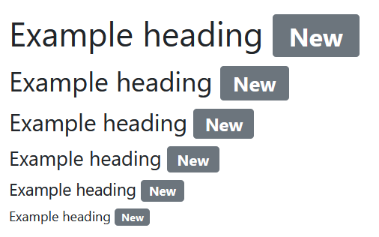
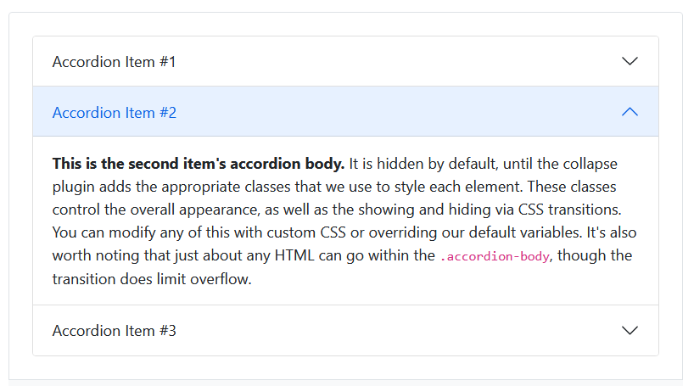
Bootstrap
Provides utilities, components, and a grid

Slide 76
Bootstrap Grid

Slide 77
Bootstrap Grid
<div class="container">
<!-- Stack the columns on mobile by making one full-width and the other half-width -->
<div class="row">
<div class="col-md-8">.col-md-8</div>
<div class="col-6 col-md-4">.col-6 .col-md-4</div>
</div>
<!-- Columns start at 50% wide on mobile and bump up to 33.3% wide on desktop -->
<div class="row">
<div class="col-6 col-md-4">.col-6 .col-md-4</div>
<div class="col-6 col-md-4">.col-6 .col-md-4</div>
<div class="col-6 col-md-4">.col-6 .col-md-4</div>
</div>
<!-- Columns are always 50% wide, on mobile and desktop -->
<div class="row">
<div class="col-6">.col-6</div>
<div class="col-6">.col-6</div>
</div>
</div>

Slide 78
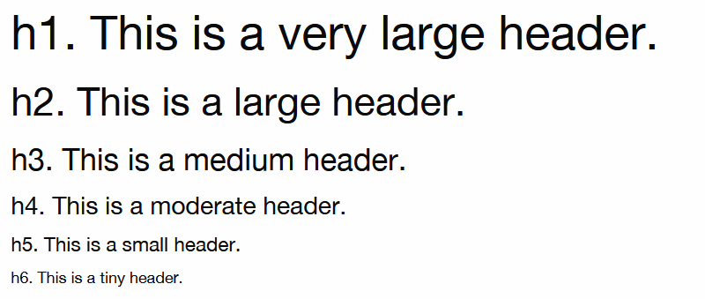
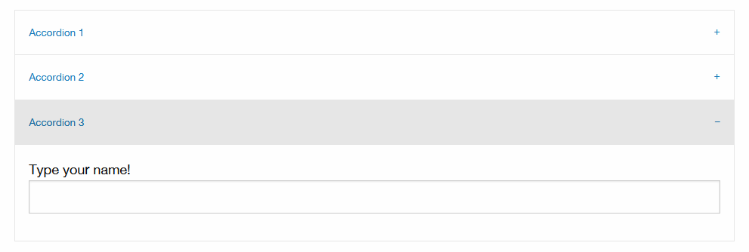
Foundations
Provides utilities, components, and a grid

Slide 79
Foundations Grid

Slide 80
Foundations Grid
<div class="grid-x">
<div class="cell">full width cell</div>
<div class="cell">full width cell</div>
</div>
<div class="grid-x">
<div class="cell small-6">6 cells</div>
<div class="cell small-6">6 cells</div>
</div>
<div class="grid-x">
<div class="cell medium-6 large-4">12/6/4 cells</div>
<div class="cell medium-6 large-8">12/6/8 cells</div>
</div>

Slide 81
Framework Differences
Class names
Number of class
Which elements the class needs to be added on
Default styling
CSS Pre-processor/Compiler both use SASS
Bootstrap used to use Less
Flexibility?
The internet informs me that foundations is more flexible with the tradeoff of being "more complicated."
Popularity?
Bootstrap is supported by twitter and much much more popular/used
Browser Support
Bootstrap IE 11+ (only with v4 and below) and Foundations IE9+ (as of July 2021)
box-sizing
Bootstrap is border-box by default Foundations appears to use content-box with a utility to set border-box

Slide 82
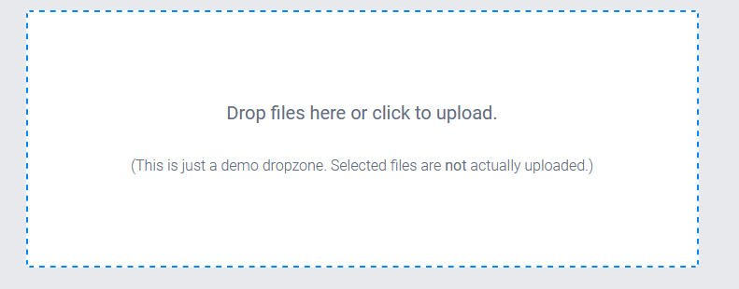
JS/CSS Plugin Example: Dropzone.js
It is a JS library for drag and drop file uploading
You add it to your site by including some JS and some CSS
<form action="/file-upload" class="dropzone" id="my-awesome-dropzone"></form>
Then it has some default styling for the place to upload files, the text, and the success styling

Slide 83
Opinions/prefixes/namespaces
While scaling out CSS one of the main issues people run into is consistency in naming
How to tell where a class can be used or what it is for by its name?
Reusable by its name?
Semantic vs descriptive/presentation (.promotion-pop-up vs .overlay or .product-listing vs .tile)
In JavaScript properties are camel case so one common pattern is having CSS class names be hyphenated as this matches css properties and values
With debates on if the IDs should be similarly hyphenated if they are for CSS only
Separate ids/classes for your JavaScript hooks and CSS might avoid breaking either
There is the "BEM" or Block Element Modifiers for example .nav__secondary--blue
Prefixing a class for .t- for theme related rules or .u- for utilities
If you are using a framework for 99% of things and you write only a few classes maybe you prefix your classes with something like .project-name-class so people know it is custom
Plugins may prefix their classes with .plugin-name to avoid conflicts as well

Slide 84
Takeaways
Important questions
Where will the CSS you are writing be loaded?
What other CSS surrounds what you are working on?
Test your CSS in all browsers and screen sizes you are supporting

Slide 85
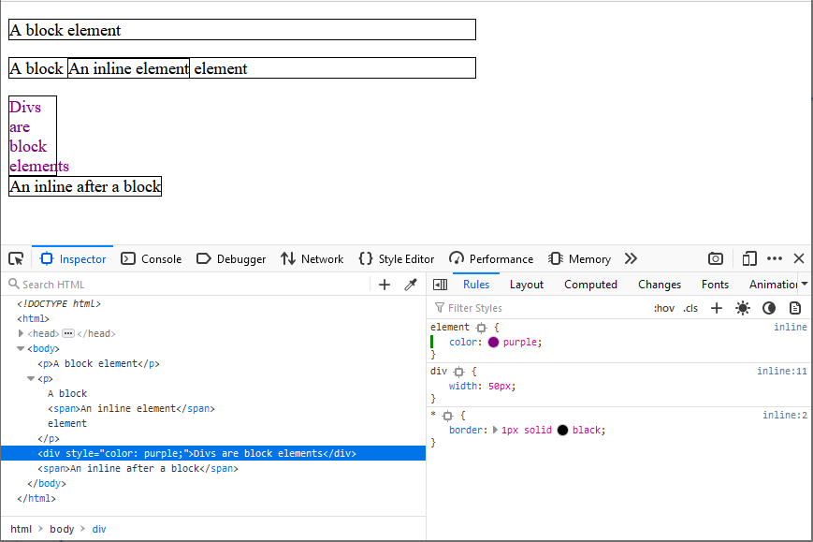
Browser Inspection Tools

Slide 86
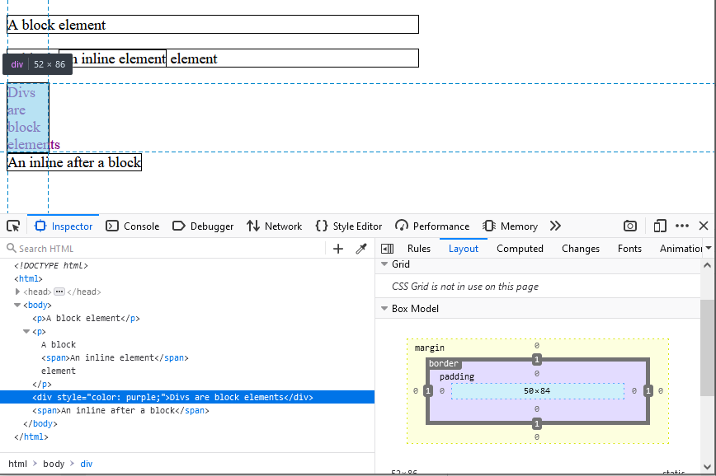
Browser Inspection Tools

Slide 87
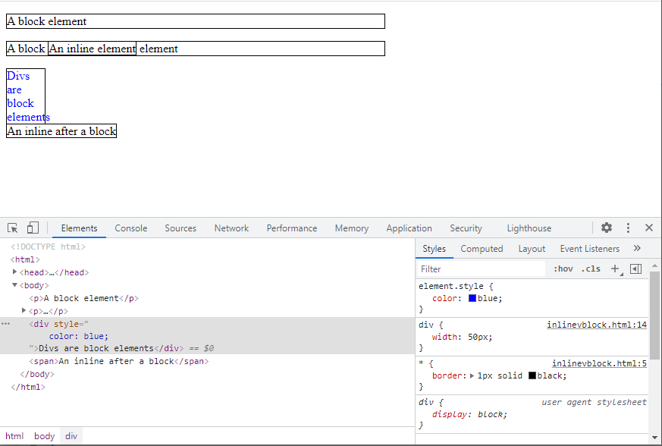
Browser Inspection Tools

Slide 88
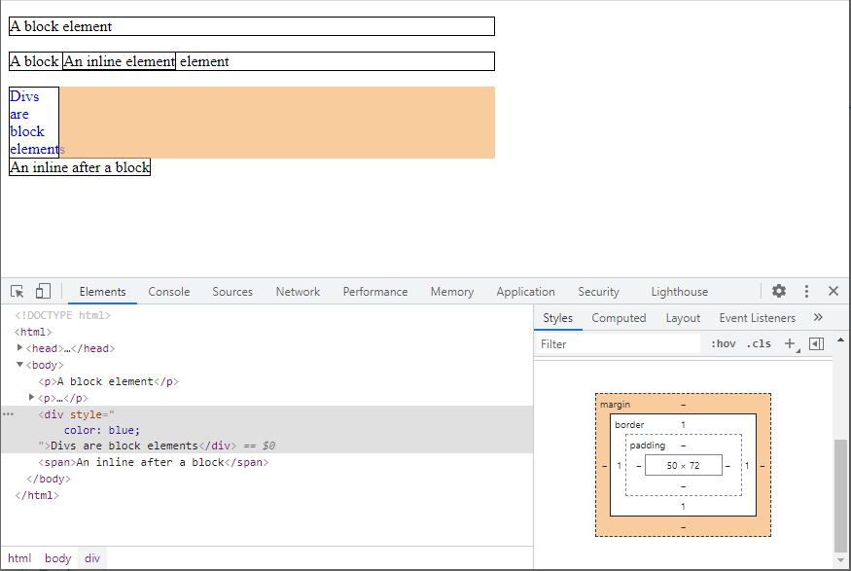
Browser Inspection Tools

Slide 89
Code "smells"
You have !important
Don't have !important
You have CSS that is "append only"
The less CSS you have the generally better off you are
If you find yourself making new CSS classes every time you do something maybe you can try to write a few classes to reuse (applies slightly less in the beginning)
It is easy to be too specific; for example using IDs for everything is similar to the problem above where CSS is only for one thing

Slide 90
Things to keep in mind
JavaScript is changing the styles after they load
Hard coded heights and widths ruin your responsive efforts
Unsupported properties or values
You might be using CSS that isn't supported yet in some browsers
Some properties or new features have browser-prefixes where you specify the property multiple times to ensure cross browser similarity
If you want to use a specific CSS selector or property go to https://caniuse.com/ and compare the browser compatibility chart with your needs
Look-up properties and their allowed values paying attention to units. I recommend: https://developer.mozilla.org/en-US/docs/Web/CSS3
Accessibility
For example some of my examples only make distinctions on color this is not recommended

Slide 91
Other things of possible interest
There are two major "compiled" CSS options (more like pre-processors)
You'll note that since CSS is just a file you serve it up and it just works you don't have to "do" anything to it
However if you want things like variables or other fancy features you can write CSS in SASS/SCSS or Less
You can "minify" CSS to make it smaller on page loads
You can animate things with CSS
Its near the top of the cascade above normal author declarations
Throw a border around everything can sometimes be a debugging tool
CSS matters in i18n. Directions and layouts often swap between languages
Many ways to handle custom themes but a common one is to separate out theme relevant selectors and make multiple style sheets only loading the relevant one via JavaScript or server side decisions

Slide 92
Conclusion
You can do this
Thank you

Slide 93
General Resources
https://css-tricks.com/
Generally if you have an idea of what you want something to look like this is a cookbook
https://developer.mozilla.org/en-US/docs/Learn/CSS
https://codepen.io/pen/
Quick testing in-browser of your elements without having to save out files to your desktop etc
A more complete list of CSS Selectors: https://developer.mozilla.org/en-US/docs/Web/CSS/CSS_Selectors
http://www.csszengarden.com/
It is the same markup styled by different people
https://www.awwwards.com/
https://wattenberger.com/blog/css-percents
https://www.w3.org/Style/CSS20/history.html
https://developer.mozilla.org/en-US/docs/Web/CSS/Using_CSS_custom_properties

Slide 94
References
CSS Syntax Really Cool Example: https://codepen.io/marcobiedermann/full/osurh
Property List
https://developer.mozilla.org/en-US/docs/Web/CSS/CSS_Properties_Reference
The cascade 2020 Snapshot: https://www.w3.org/TR/css-cascade-4/#cascade-sort
Specificity: https://www.w3.org/TR/selectors/#specificity
Box Model: https://developer.mozilla.org/en-US/docs/Learn/CSS/Building_blocks/The_box_model
Bootstrap Screenshots/Code: https://getbootstrap.com/
https://getbootstrap.com/docs/5.0/layout/grid/

Slide 95
References
Foundation Screenshots/Code: https://get.foundation/index.html
https://get.foundation/sites/docs/xy-grid.html
Flexbox: https://css-tricks.com/snippets/css/a-guide-to-flexbox/
CSS Grid: https://css-tricks.com/snippets/css/complete-guide-grid/

Slide 96
Author and Contact Info
Slides produced July 2021
Sarah Whelan
hello@sarahwhelan.com
Please reach out with any corrections, questions, or comments. They will be greatly appreciated.

